Slide 1
SD Worx
HackHR Hackathon
Davy Serneels – Product Owner
Veerle Verdick – Agile Coach
Nico Van Goethem - Architect

Slide 2
About SD Worx
01.

Slide 3
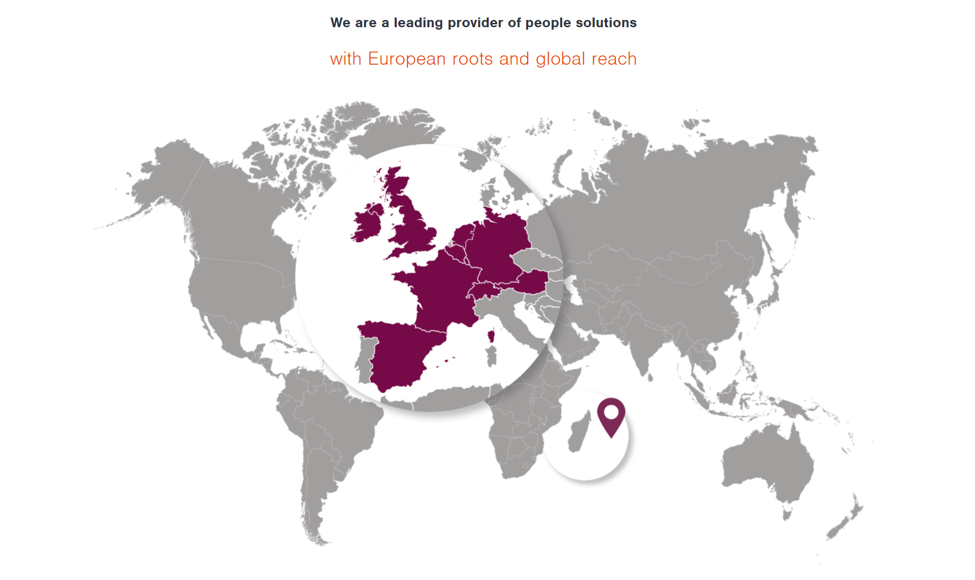
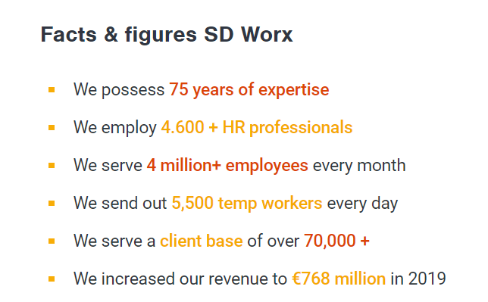
About SD Worx

Slide 4
About SD Worx
NEEDS Employee journey
VALUE How we help
Staffing & recruitment
Technology
Look for a worker + hiring
Provide software, tooling, …
Core HR
Add worker info, request assets
Outsourcing
Provide people to do the work
Payroll & Reward
Get calculated & payed !
Expertise
Workforce mgmt
Answer questions, assist, share knowledge
Planning / Absence
Insights
Talent mgmt
Provide benchmarks, predictions, statistics, …
Evaluation

Slide 5
Employee engagement
02.

Slide 6
How passionate employees feel about their jobs & feel connected to the organization, and are committed to go for the extra mile.
Employee engagement - Definition

Slide 7
Employee engagement != Employee satisfaction

Slide 8


Components of employee engagement
Motivate
Empower
Respect
Challenge
Vision
Strategy
Employees contribution
Employee Engagement
Company Culture
Motivation & Trust relationship
Management
of execution
Company Strategy
Develop teams
Motivation
Strong relationships
Expectations
Accountability
Clear communication

Slide 9
Why is it important ?
Drives performance
Company vision & strategy
Growth & innovation
Retain & attract talent
Sense of purpose → decision making

Slide 10
Drivers of engagement
Employee's personal resources
Employee perceptions of job importance
Employee clarity of job expectations
Career advancement / improvement opportunities
Regular feedback and dialogue with superiors
Quality of working relationships with peers, superiors, and subordinates
Perceptions of the ethos and values of the organization
Effective internal employee communications
Source : https://en.wikipedia.org/wiki/Employee_engagement

Slide 11
Hackathon Challenge
03.

Slide 12
What could you build that we can offer to our customers to increase their employee engagement ?

Slide 13



Digital Channels : MySDWorx
Web
Mobile
Conversational
MySDWorx
Employers
Employees
SD Worx

Slide 14
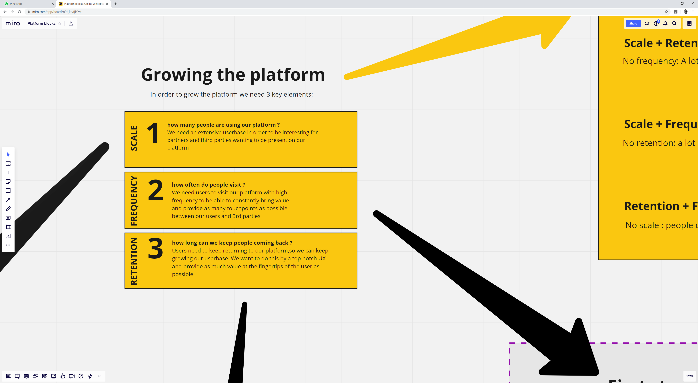
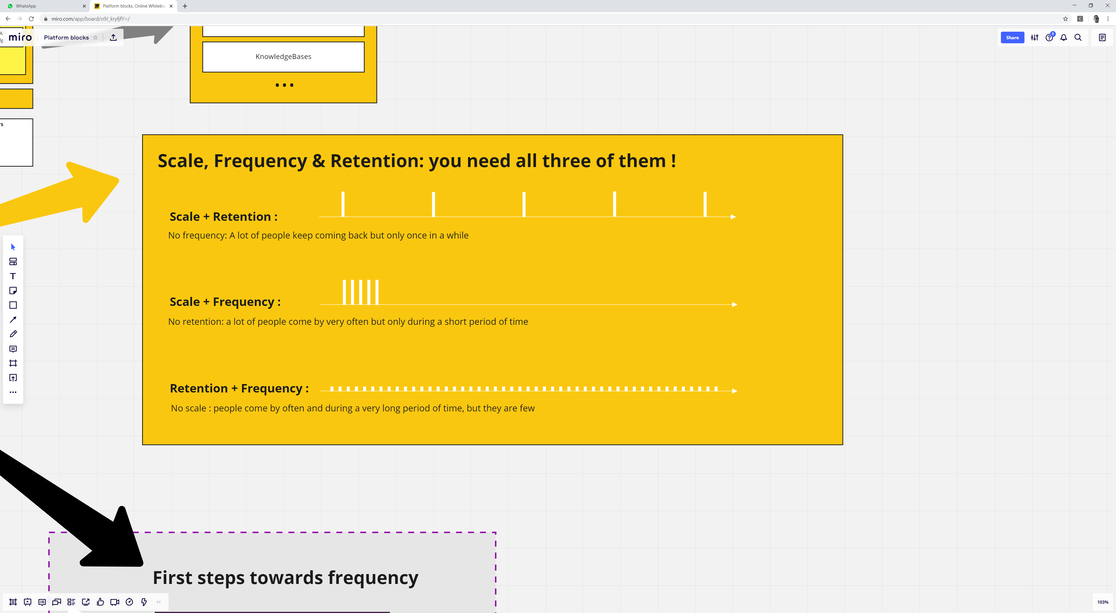
Scale, Frequency & Retention

Slide 15

Things to keep in mind
Blue vs white collar worker
Contingent workers
Company size (SME, LE, Gov, …)
International context
Scalability
Reuse of our digital channels
Measure ROI
GDPR

Slide 16

Existing Components
Identity/Onboarding
Notifications/Messaging
User Groups
Surveying
Internal communication
Digital channels

Slide 17
Adaptive Cards
https://adaptivecards.io/designer/

Slide 18


Questions

